Slide 1
Git Theory
by Saddam

Slide 2
Topics Covered
What is Git?
Git Lifecycle.
Recording changes to the repository.
what is Remote and Local respository?
what is meant by staging changes?

Slide 3
What is Git?
Git is a DevOps tool used for source code management.
It is a free and open-source version control system used to handle small to very large projects efficiently.
Git is used to tracking changes in the source code, enabling multiple developers to work together on non-linear development.

Slide 4
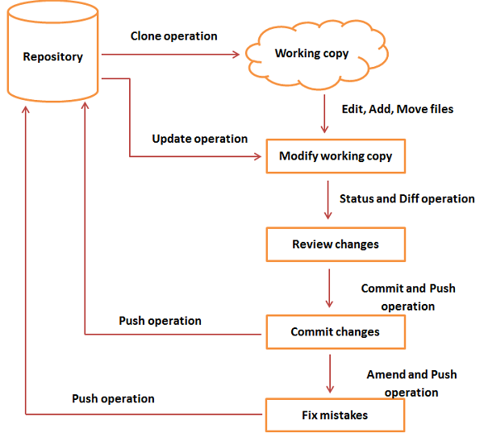
Git Lifecycle

Slide 5
Git Lifecycle
You clone the Git repository as a working copy.
You modify the working copy by adding/editing files.
If necessary, you also update the working copy by taking other developer's changes.
You review the changes before commit.
You commit changes. If everything is fine, then you push the changes to the repository.
After committing, if you realize something is wrong, then you correct the last commit and push the changes to the repository.

Slide 6
Recording changes to the repository
Each file in your working directory can be in one of two states: tracked or untracked.
Tracked files are files that were in the last snapshot, as well as any newly staged files; they can be unmodified, modified, or staged.
In short, tracked files are files that Git knows about.

Slide 7
Untracked files are everything else — any files in your working directory that were not in your last snapshot and are not in your staging area.
When you first clone a repository, all of your files will be tracked and unmodified because Git just checked them out and you haven’t edited anything.
As you edit files, Git sees them as modified, because you’ve changed them since your last commit.

Slide 8
Checking the Status of Your Files
The main tool you use to determine which files are in which state is the “ git status ” command.
Ex:- $ git status
On branch master
Your branch is up-to-date with 'origin/master'.
nothing to commit, working tree clean

Slide 9
Tracking New Files
In order to begin tracking a new file, you use the command git add.
To begin tracking the README file, you can run this “ git add README”.
The git add command takes a path name for either a file or a directory; if it’s a directory, the command adds all the files in that directory recursively.

Slide 10
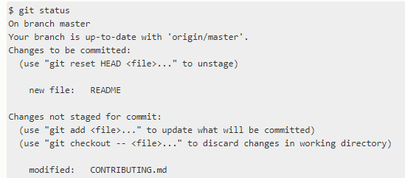
Staging Modified Files
Let’s change a file that was already tracked. If you change a previously tracked file called CONTRIBUTING.md and then run your git status command again, you get something that looks like this:

Slide 11
To stage it, you run the git add command. git add is a multipurpose command — you use it to begin tracking new files, to stage files, and to do other things like marking merge-conflicted files as resolved.

Slide 12
Committing Your Changes
The simplest way to commit is to type “ git commit “.
any files you have created or modified that you haven’t run git add on since you edited them — won’t go into this commit.
They will stay as modified files on your disk.

Slide 13
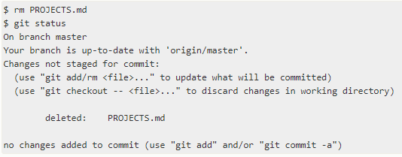
Removing Files
If you simply remove the file from your working directory, it shows up under the “Changes not staged for commit” (that is, unstaged) area of your git status output.

Slide 14
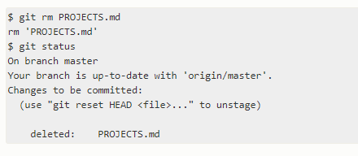
The git rm command does that, and also removes the file from your working directory so you don’t see it as an untracked file the next time around.
if you run git rm, it stages the file’s removal.

Slide 15
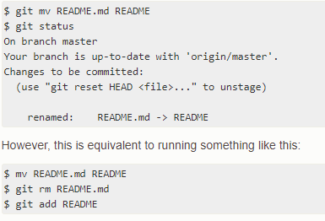
Moving Files
If you want to rename a file in Git, you can run something like:$ git mv file_from file_to

Slide 16
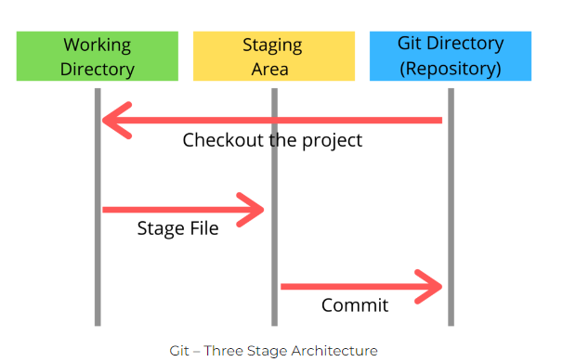
3-Stage Architecture
There are three stages those are Working directory,Staging area and Git directory(Repository).

Slide 17
Working directory specifies the file explorer’s folder where your files are stored.
Staging area is a area where your those files are present which you want to send to commit(to create snapshot of files).
After commit is fired, files which are in staging area will move to Git Repository.

Slide 18
what is Remote and Local respository?
Local repositories reside on the computers of team members.
The entire work of Git is based on this repository, it tracks the history and safeguards it. It also helps the user switch between the previous versions.
You can commit your changes into your repository directly, using the command:git commit -m

Slide 19
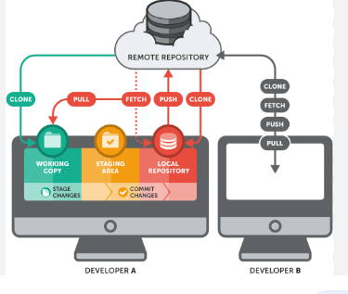
Remote repositories are hosted on a server that is accessible for all team members, most likely on the internet or on a local network.

Slide 20
what is meant by staging changes?
In Git, just because a file was modified doesn't mean it will be automatically included in the next commit.
Instead, you have to tell Git explicitly which of your modifications shall be part of the next commit.
This is done by adding a change to the Staging Area.

Slide 21
Thank you

